Slide 1
Group 7
CampSnap Presentation
Team Members
Danny Canter: Frontend Designer
Omar Oropeza: Scrum Master
Giselle Lubin: Backend Designer
Timothy Giles: Product Owner

Slide 2
URL TO YOUTUBE VIDEO
https://www.youtube.com/watch?v=81RojqRczBE&feature=youtu.be

Slide 3
URL To Final Product
http://lamp.cse.fau.edu/~cen4010sum18_g07/campsnap/login.php

Slide 4
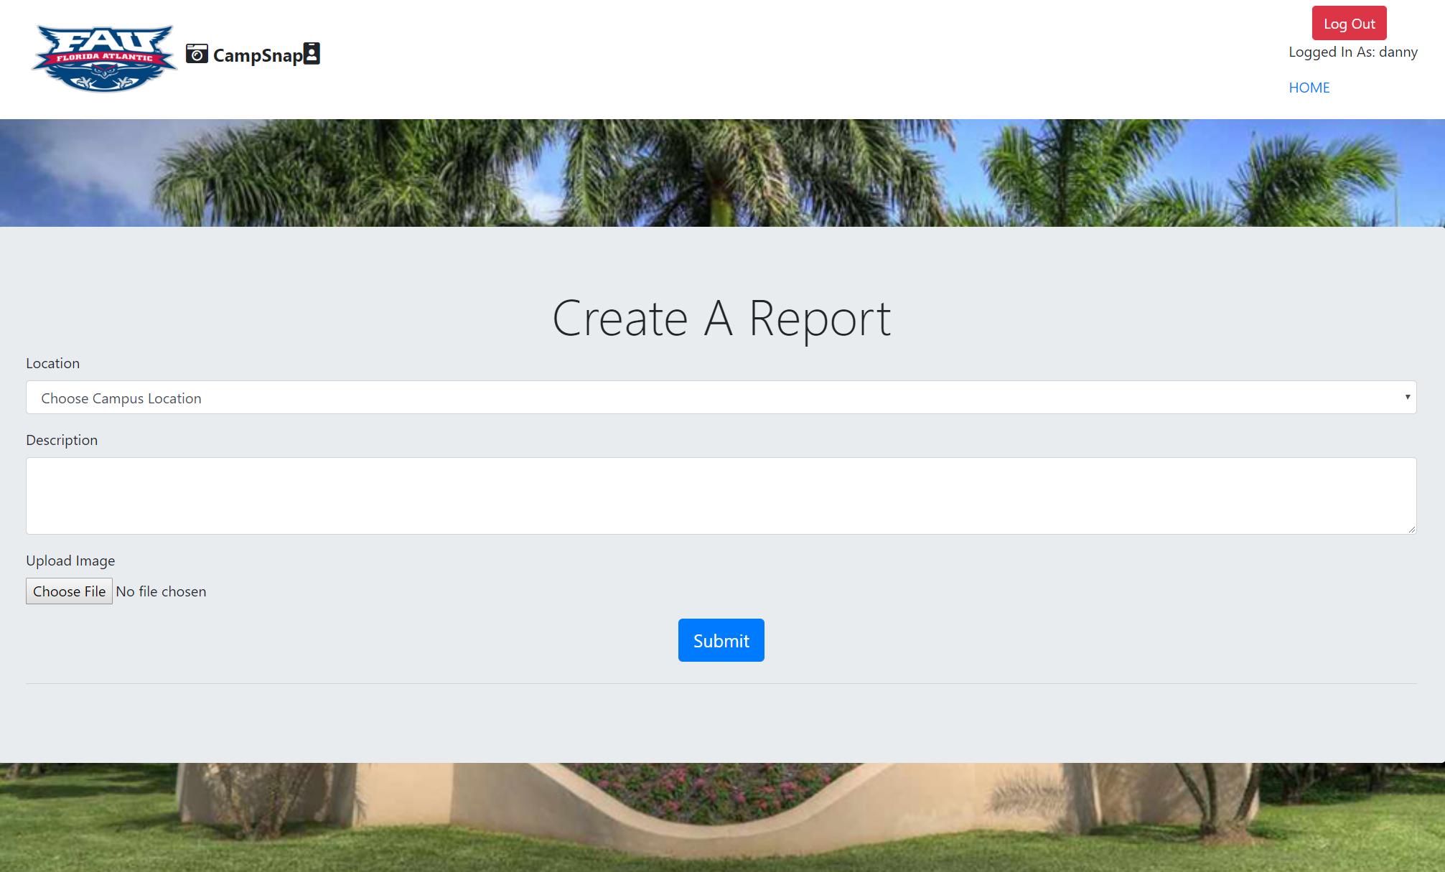
Motivations For CampSnap
Our team wanted to develop a tool that made it easier to fix the kinks around campus that might seem like they go unnoticed. See a leaky faucet, cracked curb, or dead lightbulb? Simply open up our website and report it and see the progress of it being fixed. No more wondering if it will ever be fixed.
Target Audience
Our target audience is obviously students and faculty of Florida Atlantic University.
Functionalities
The core functionalities of our app is the ability to upload a report with a description and an image of the issue. This report will then show up on the main page and you can view the status of it by clicking the View Status button.
Motion design
User experience
Physical Computing

Slide 5
System Implementation Infrastructure
Backend Language: PHP Database: MySQL
Client Side Language: Javascript and the JQuery UI
library for the login page.
CSS Library: Bootstrap
Standard HTML

Slide 6

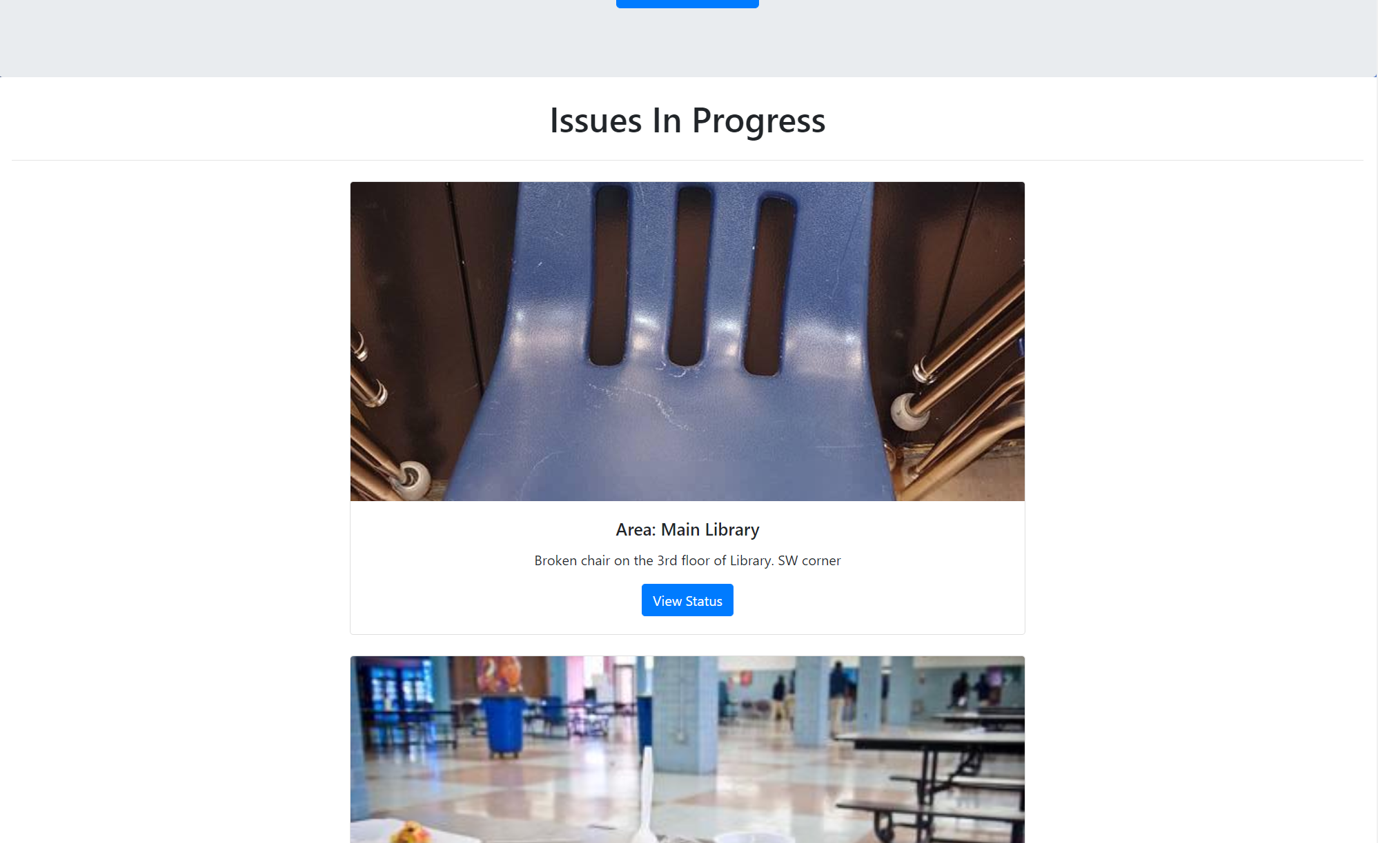

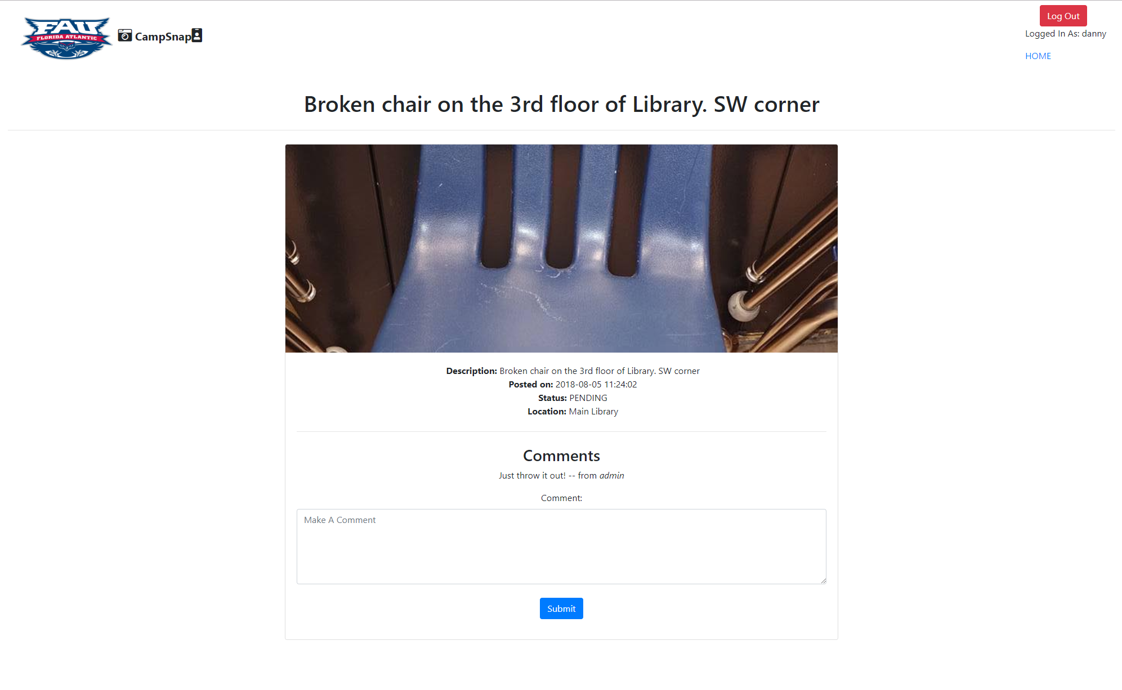
CampSnap Photo Gallery

Slide 7
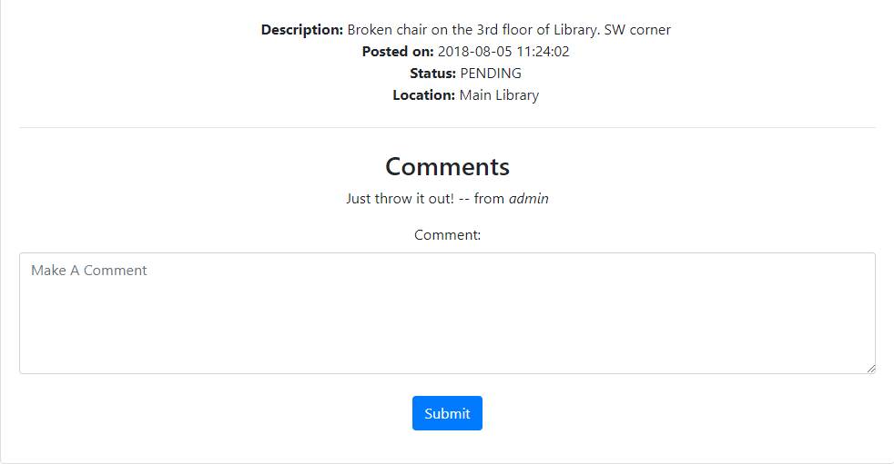
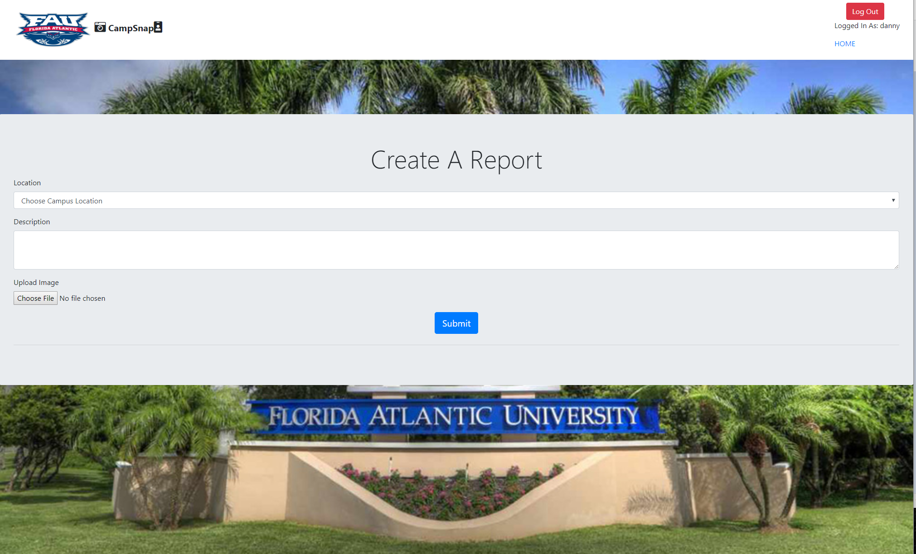
Finished Features
Viewing The Status Of A Report and Comment Functionality
Image Upload And Location Choice.

Slide 8
Finished Features
-Photo Upload
-Location Selection
-Checking the status of a report
-Being able to comment on a report.

Slide 9
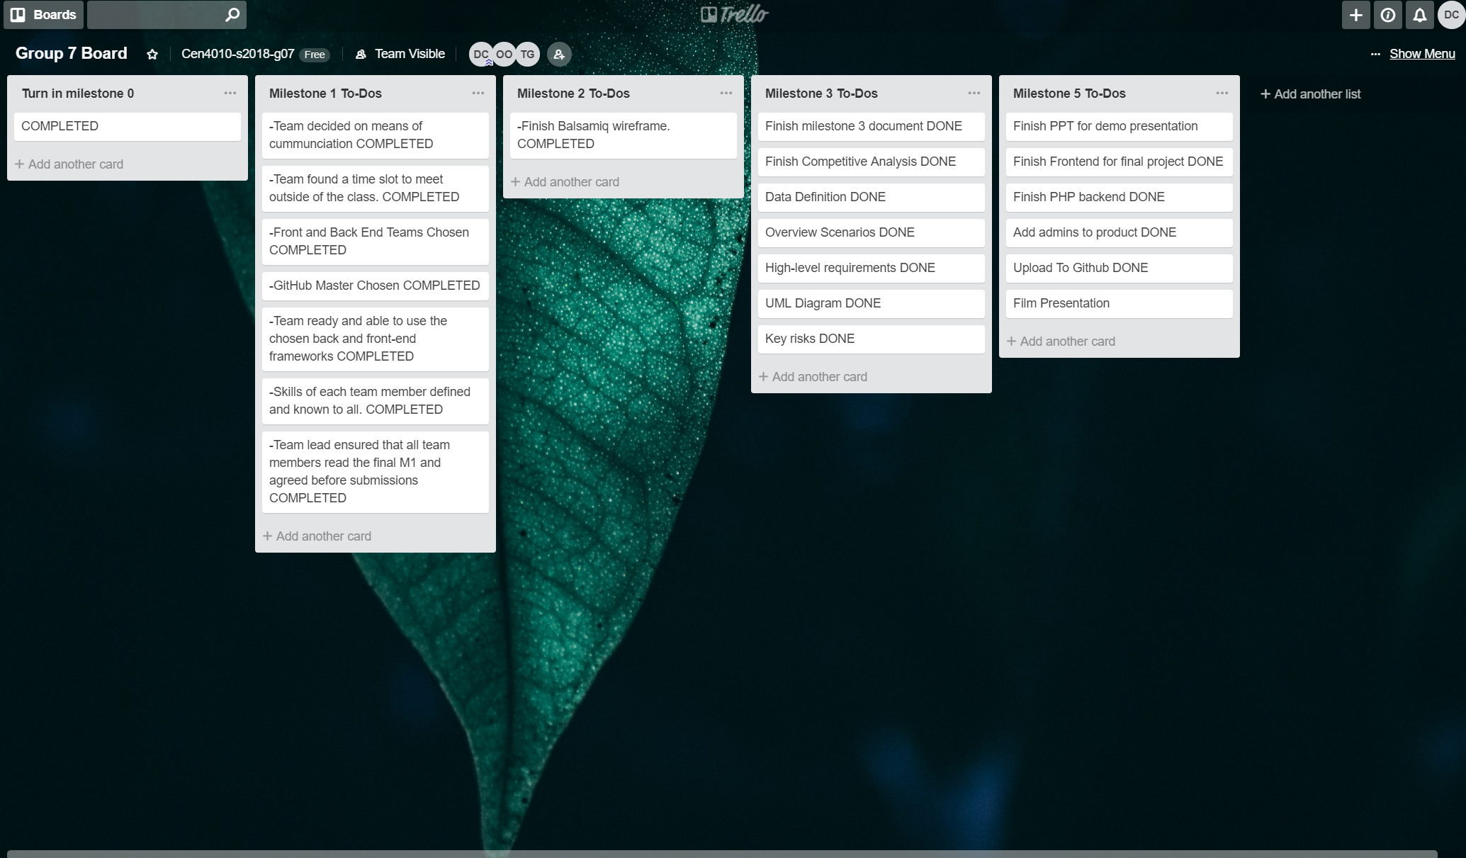
Trello Backlog

